Slide 1
Ecommerce Database & Analytics Platform
Owen Randolph, Gabe Tharp, and Marcos Fernandez
Notes:
Our project is an Ecommerce Database and Analytics Platform built using Amazon Web services. The purpose is to store and manage transactional data, and leverage Amazon QuickSight as the business intelligence layer to visualize sales, profit, and regional trends for actionable insights.

Slide 2


Project Scope
Organizing confusing information
Visualizing KPIs
Driving internal decisions
Notes:
The aim of our project is to provide users of an e-commerce company detailed and up-to-date information about various aspects of their business starting from unorganized data and ending with a visually appealing and interactive dashboard. The goal is that this dashboard will help inform internal stakeholders where to allocate resources based on profit, region, sales, and volume data.

Slide 3
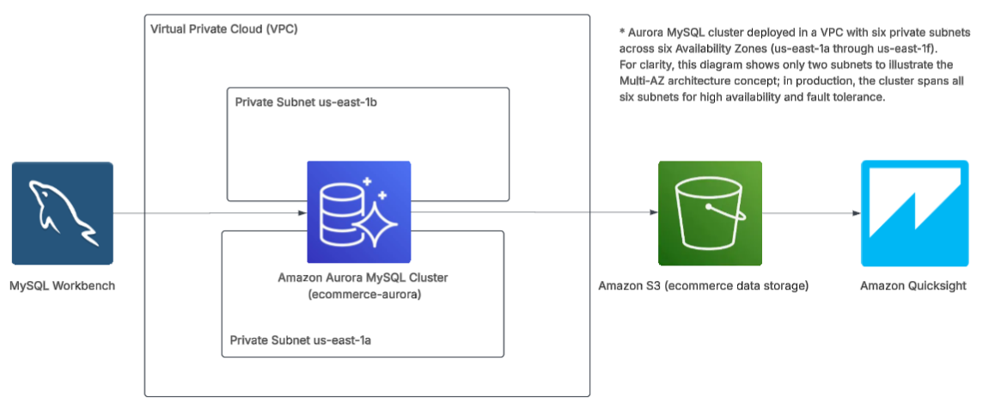
Project Architecture
Notes:
We the modelled the data in MySQL Workbench, stored it in an Aurora MySQL cluster within a secure VPC, exported to S3 for scalable storage, and then connected to QuickSight for interactive dashboards.
Aurora and S3 allow for highly scalable, secure, high performing and highly resilient work loads.

Slide 4
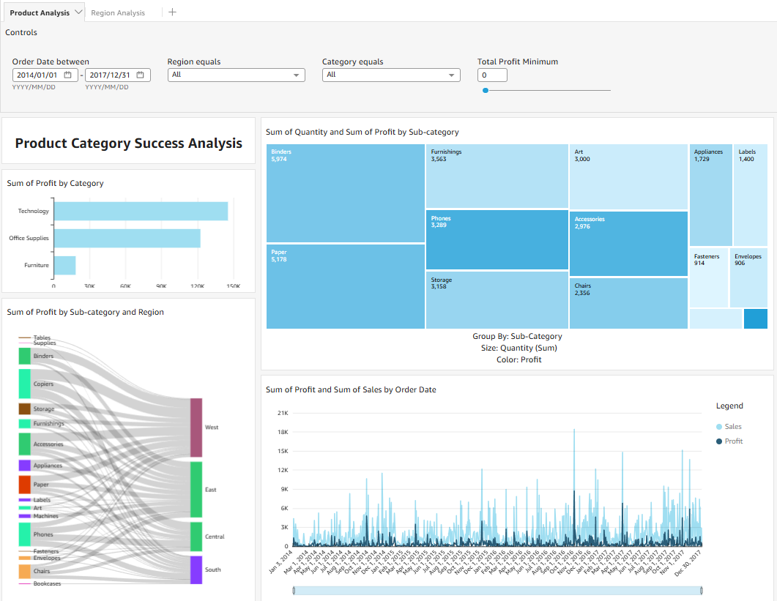
Product Analysis Dashboard
Considerations for:
Marketing
Inventory
Supply Chain
Sales Efforts
Notes:
At the top of the dashboards, users can filter the visualization data by date range, region, product category and minimum profit.
The bar chart identifies top-performing categories for marketing and sector investment strategies
The tree map shows users which sub-categories contribute most volume and profit, guiding decisions on scaling production or focusing on promotional efforts
The Sankey diagram shows profit by sub-category and region, allowing stakeholders to see which sub-categories are most profitable in which region, guiding resource allocation and campaigns
And the line diagram has sales profit and volume by date to identify seasonality, demand spikes, growth trends for inventory planning, marketing scheduling, and sales forecasting

Slide 5
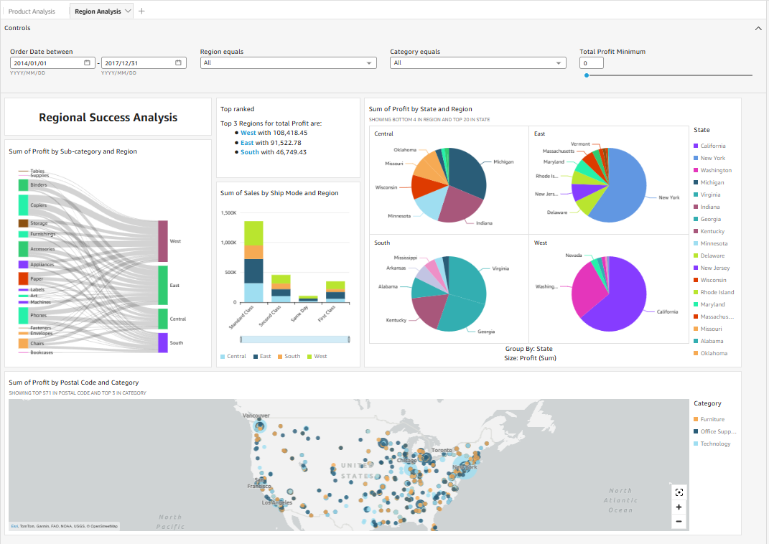
Region Analysis Dashboard
Considerations for:
Marketing
Inventory
Logistics
Sales Efforts
Notes:
Total profit by region identifies which categories are leading profit helping stakeholders prioritize investment, marketing, and inventory decisions for high-performing categories.
Text Insight highlights which sub-categories perform best in each region, enabling targeted regional strategies
The Shipping mode bar chart is broken down by regions, guiding logistics decision making
The pie charts reveal the most profitable states per region for marketing campaigns and inventory distribution
Finally, the geographic map: Provides at-a-glance insight into categorical performance and trends by region, supporting strategic decisions like where to allocate resources or open new distribution centers.

Slide 6
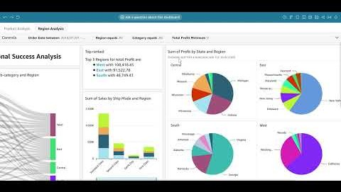
Application Demonstration

Slide 7
Possible Additions for Expansion
Deploy as embedded dashboard on a website
Pipeline expansion for
Data Ingestion from other sources
Data flow Automation
ETL
Data Warehouse
Machine Learning
Report Building
Notes:
Although QuickSight does not allow a standalone URL, it can be embedded into a company website or portal
AWS offers a world of options for working this database and dashboard into a more robust pipeline including
Data Ingestion from other sources (using an API Gateway)
Data flow Automation (using AWS Lambda)
ETL for improved query performance (using AWS Glue)
Data Warehouse for optimizing analytics performance at scale (with Amazon Redshift)
Machine Learning applications (with Amazon Sagemaker)
Generative AI summaries of the data and anomaly detection (with Amazon Q)

